Slide 1
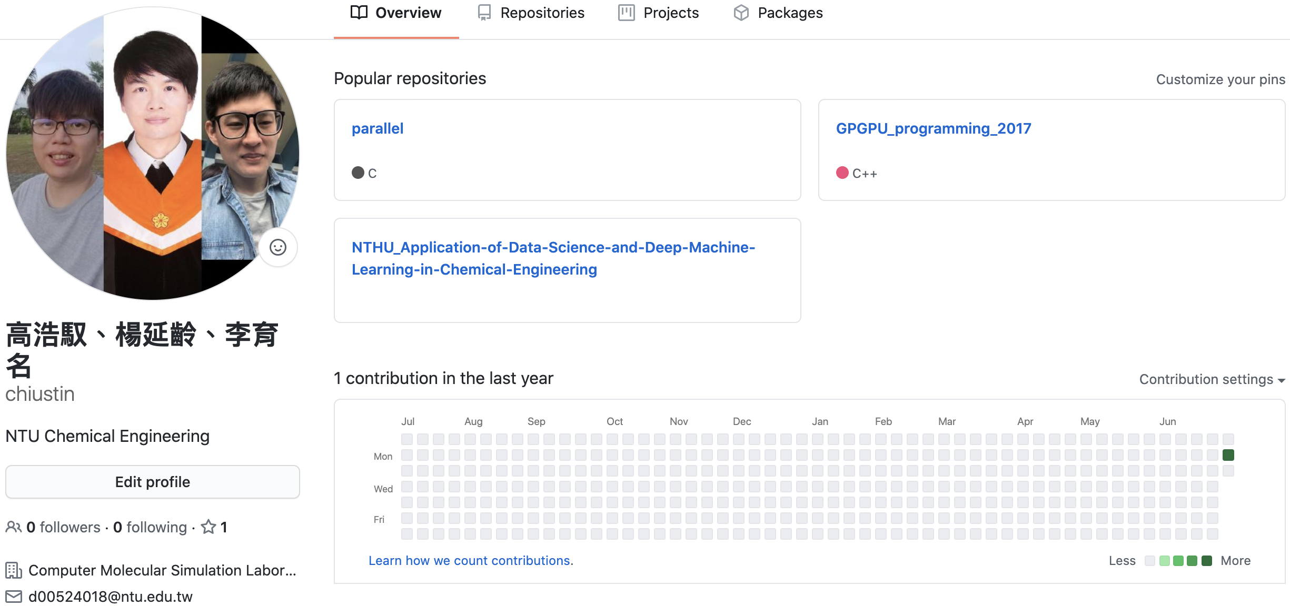
https://github.com/chiustin

Slide 2
Python (I)
- Introduction
Basic Data Types
Built-in Types
楊延齡 博士
hayato655169@gmail.com
07/07/2020

Slide 3






Advantage
1
Readability
Cross-platform
It's Free
Extensible

Slide 4


Package
2
Package | Feature
Numpy | Base N-dimensional array package
Pandas | Data structures and data analysis tools
SciPy | Fundamental library for scientific computing
Matplotlib | Comprehensive 2D Plotting
RDKit | Cheminformatics and machine-learning software
Biopython | A set of freely available tools for biological computation
SciKit-Learn | A set of modules for machine learning
Keras | A deep learning API written in Python

Slide 5
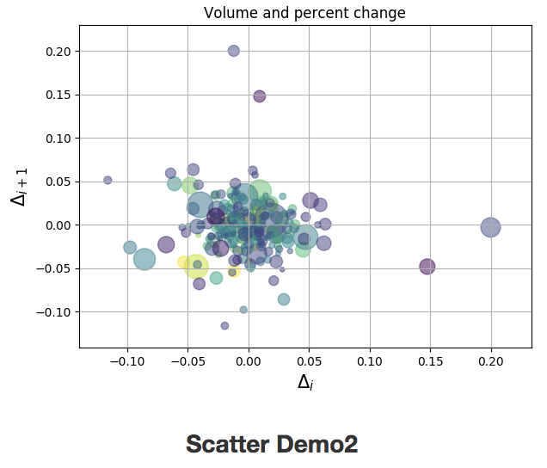
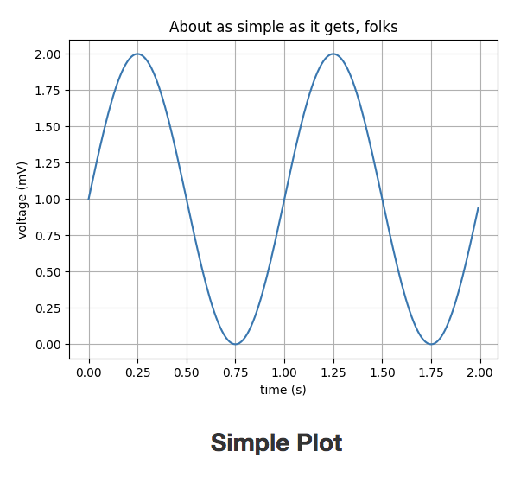
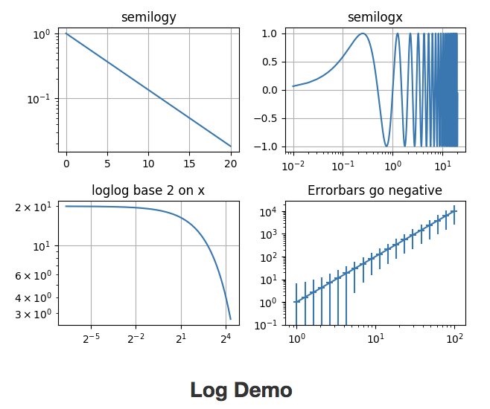
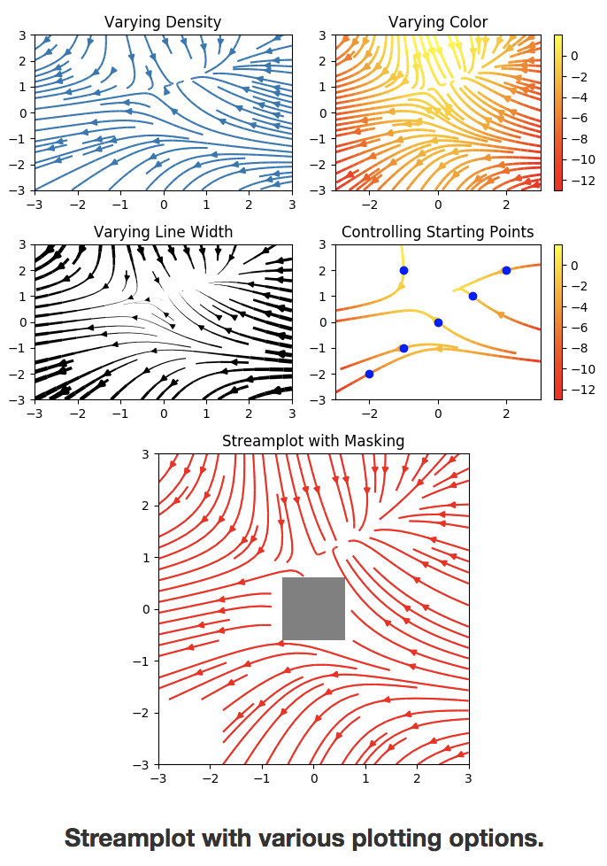
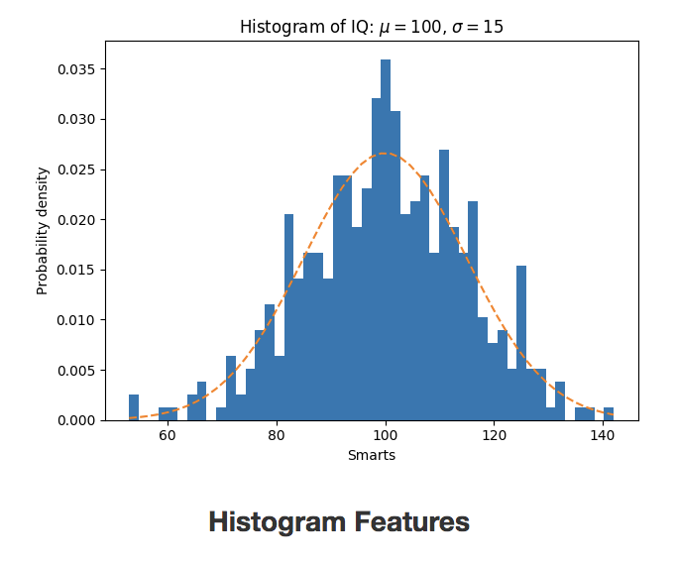
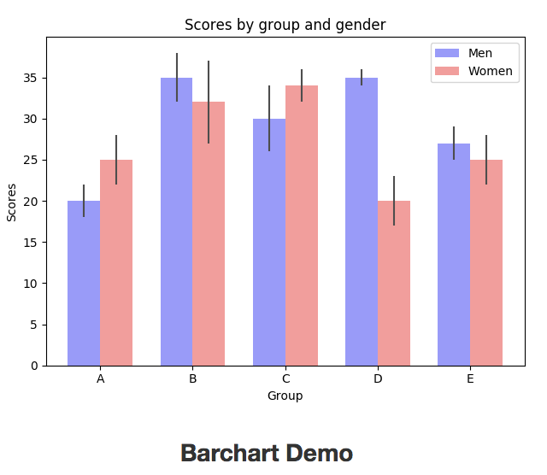
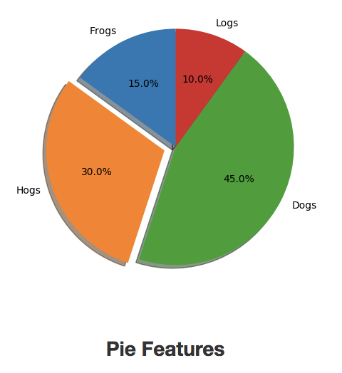
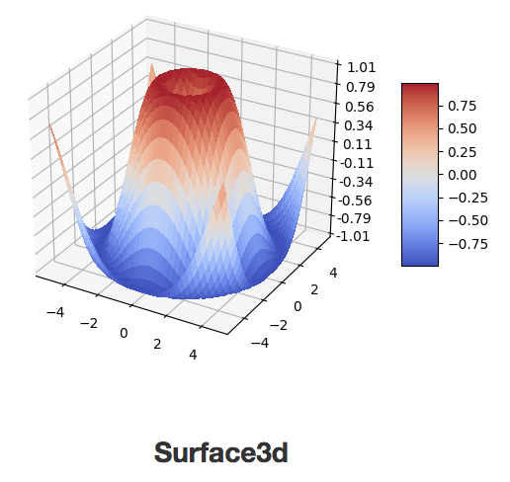
Matplotlib Package for Visualization in Python
3

Slide 6




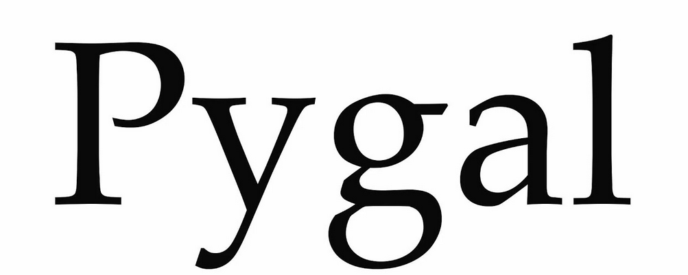
Top 5 Python Data Visualization Libraries
4

Slide 7




Other Package
5
Game Development
Pygame
Web Framework
Django
Graphical User Interface
GUI
Natural Language Processing
NLTK

Slide 8

Python Best IDEs in 2020
6
Jupyter
Google Colaboratory
Visual Studio Code
PyCharm
Spyder
Vim
Sublime Text 3
Thonny
Atom
PyDev

Slide 9
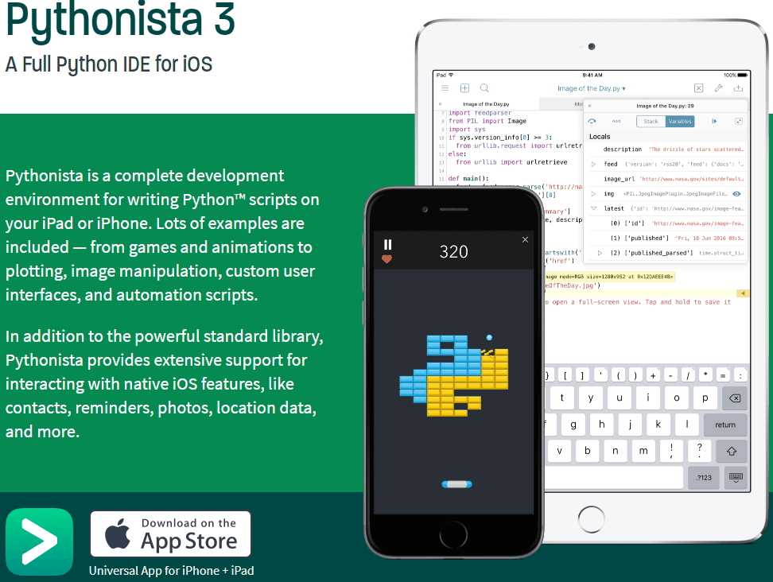

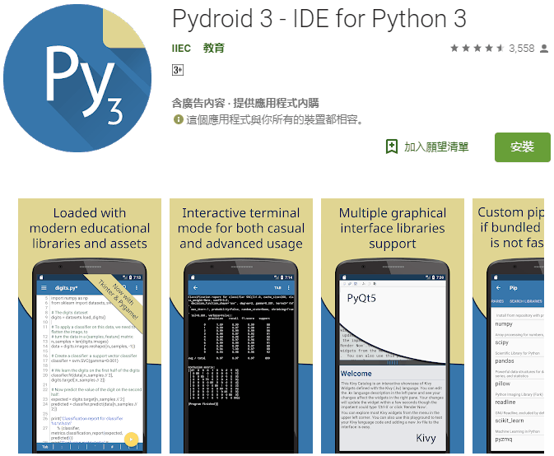
Python Smartphone App
7

Slide 10

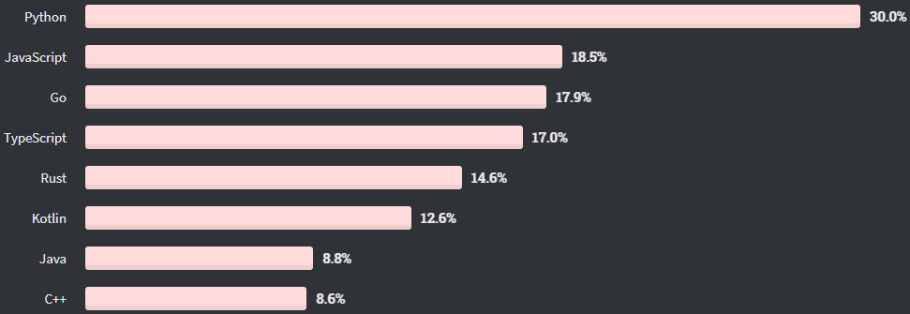
Most Wanted Programming Languages
8

Slide 11
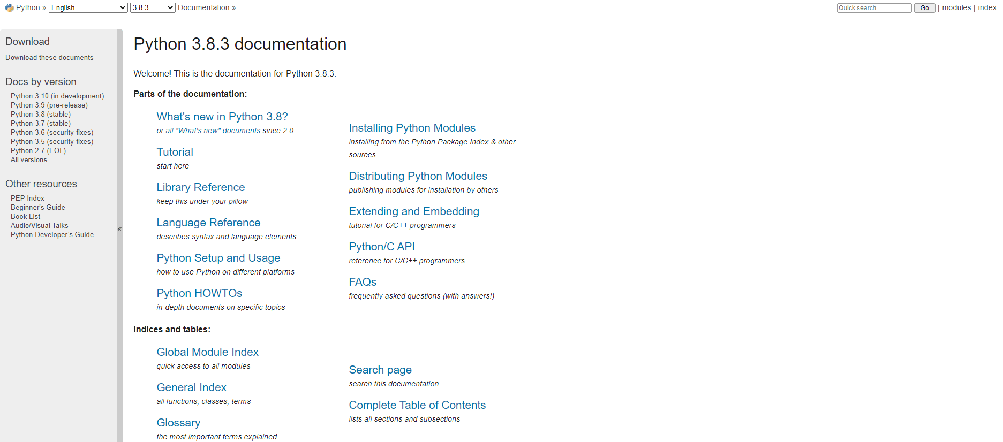
Python Document
9
Link

Slide 12

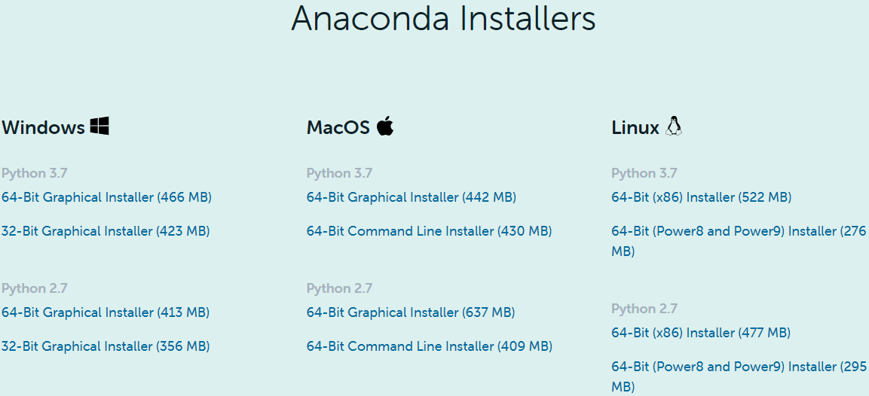

Installation
10
優點：處理有關資料分析與科學計算套件齊全
缺點：占空間
Step 3:
Step 1:
https://www.anaconda.com/download
Step 2:

Slide 13
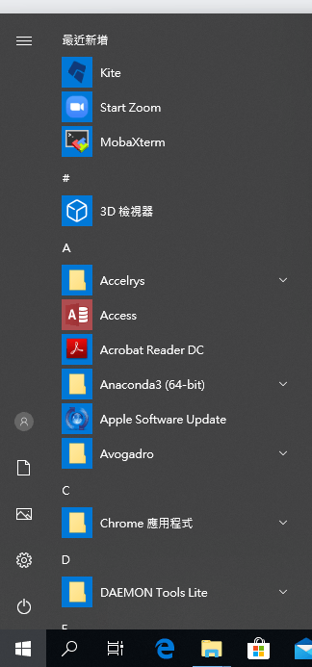
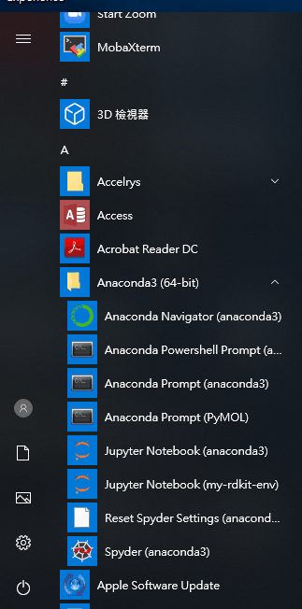
Anaconda Navigator (anaconda3)
11
Step 1.
Step 2.

Slide 14

JupyterLab
12

Slide 15
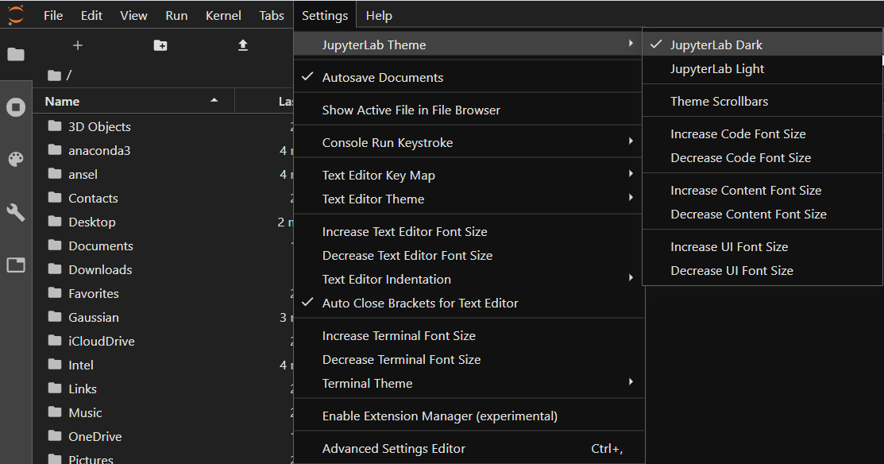
Theme
13

Slide 16
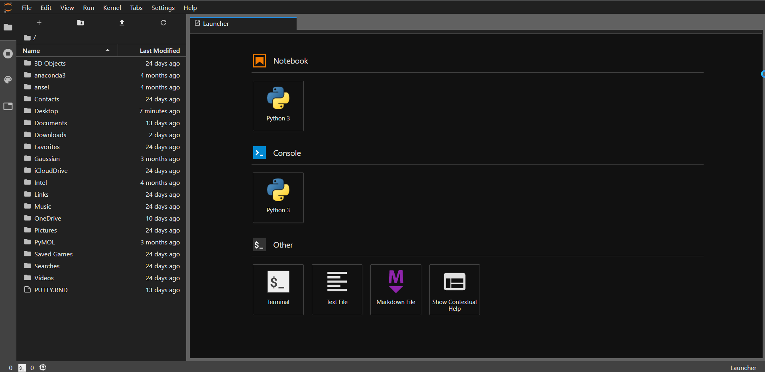
JupyterLab
14
Folder path
Create a Python project﻿
Folder

Slide 17
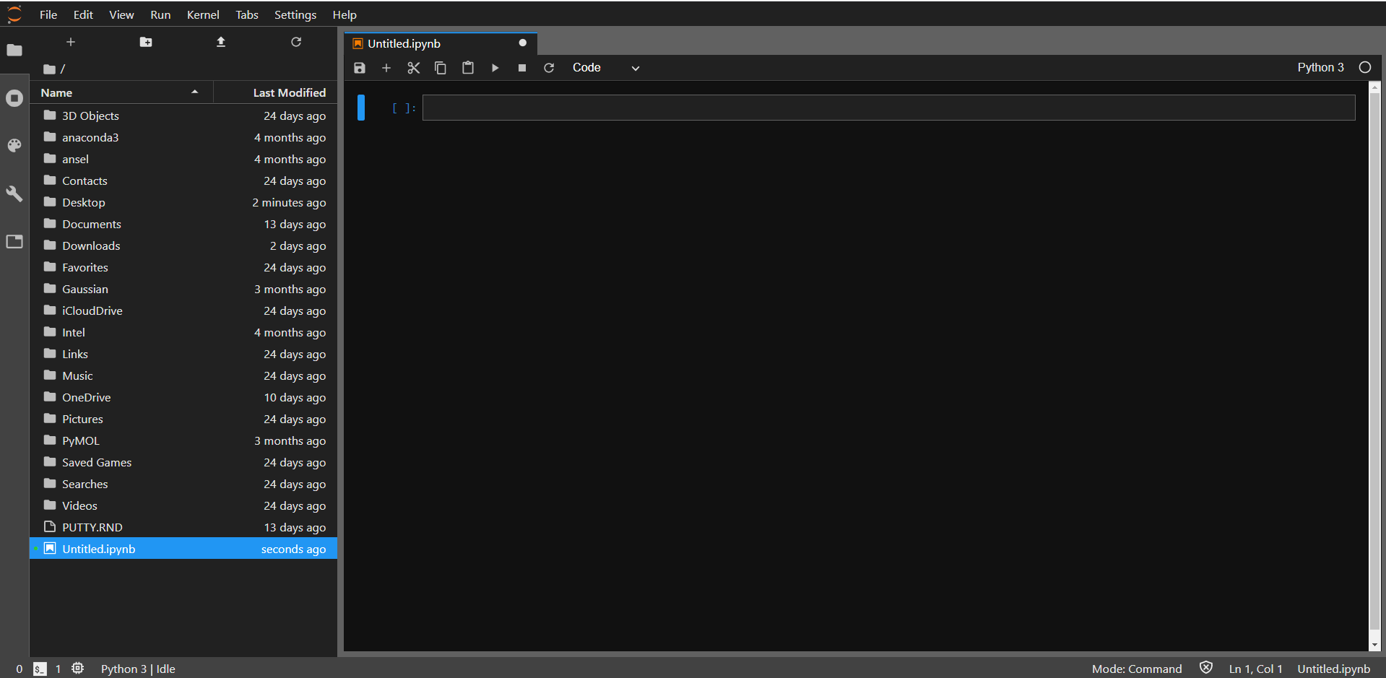
JupyterLab
15
File

Slide 18
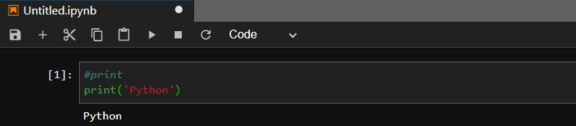
Compile
16
2
1
Code
3
Output Area
Code
Comment
>>> #print
Statement
>>> print('Python') # => Python

Slide 19
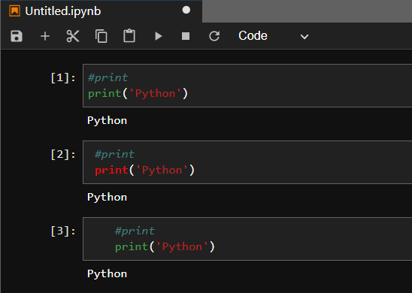
Fixing Python Indentation
17
Space
Tab
Statements should be left-aligned to the same indented level

Slide 20
JupyterLab
18
Command Mode
Ctrl+Enter | Run cell
Shift+Enter | Run cell, select below
Alt+Enter | Run cell, insert below
Ctrl+S | Save and Checkpoint
A/B | Insert cell above/below
DD | Delete selected cell
C | Copy selected cell
V | Paste cell below
Shift+V | Paste cell above
X | Cut selected cell
Z | Undo last cell deletion
Save
Insert a cell below
Cut the selected cell
Copy the selected cell
Paste cells
Run the selected cells
Interrupt the kernel
Restart the kernel

Slide 21


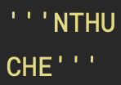
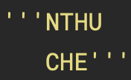
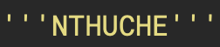
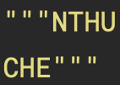
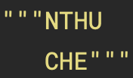
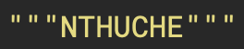
Python Comment
19
Single-line comments
Multi-line comment
Hash #
Hash #
Triple single quotes '''
Triple single quotes '''
Triple double quotes """
Triple double quotes """
''' & """ don’t be left-aligned to the same indented level

Slide 22
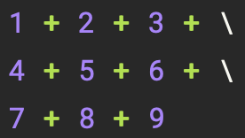
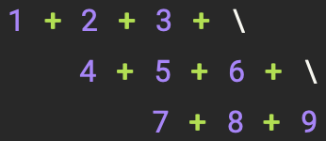
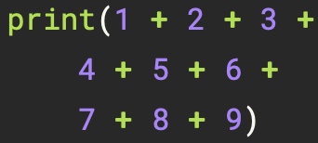
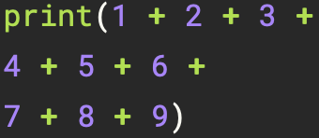
Python Statement
20
Single-line statement
Multi-line statement
Back slash \
Parentheses ( )
Semicolons ;
print (): prints the given object to the standard output device (screen)
Other
brackets [ ] and braces { }

Slide 23
Object
21
Python is an object oriented programming language
Almost everything in Python is an object, with its properties and methods

Slide 24
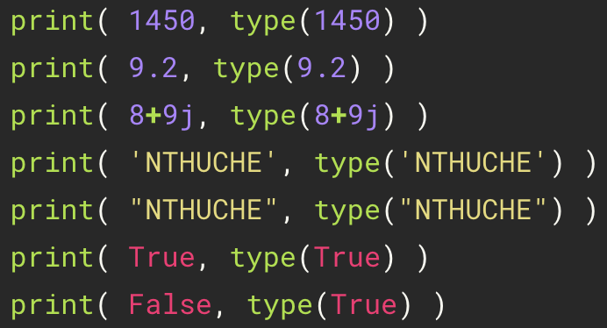
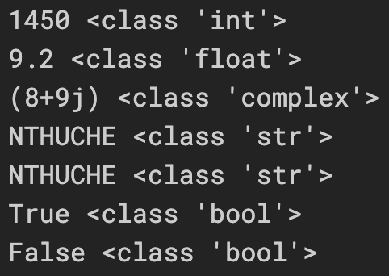
Basic Data Types
22
type (): returns type of the given object
Type | Meaning | Example
int | Integer | 1450
float | Floating point | 9.2
complex | Complex | 8+9j
str | String | "NTHUCHE" 'NTHUCHE'
bool | Boolean | True (1)、False (0)
Strings can be enclosed in single quotes ('...') or double quotes ("...")

Slide 25
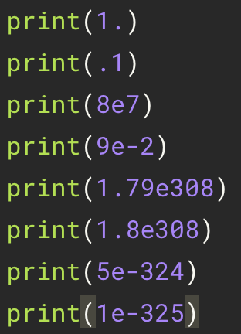
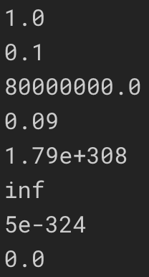
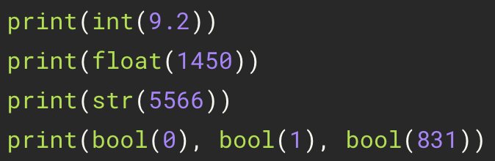
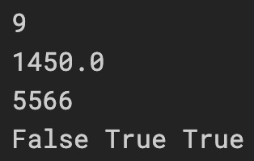
Basic Data Types
23
Floating-Point Numbers
Casting

Slide 26
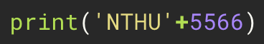
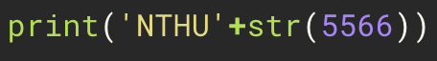
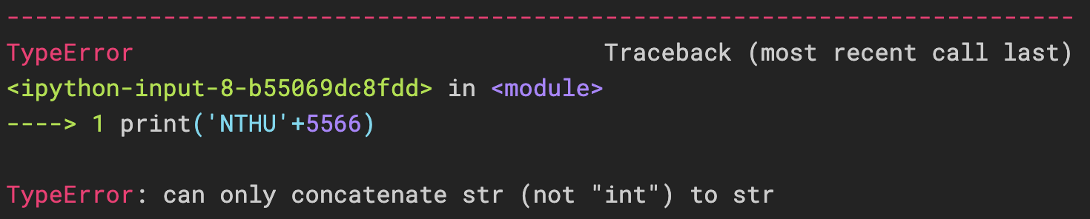
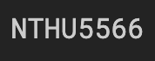
Basic Data Types
24
incorrect
correct

Slide 27
Python Operators
25
Arithmetic Operators | Meaning | Example
+ | Add two operands or unary plus | a + b +1
- | Subtract right operand from the left or unary minus | a – b -1
* | Multiply two operands | a * b
/ | Divide left operand by the right one (always results into float) | a / b
** | Exponent - left operand raised to the power of right | a ** b
// | Floor division - division that results into whole number adjusted to the left in the number line | a // b
% | Modulus - remainder of the division of left operand by the right | a % b

Slide 28
Python Operators
26
Assignment Operators | Example | Equivalent to
+= | a += b | a = a + b
-= | a -= b | a = a - b
*= | a *= b | a = a * b
/= | a /= b | a = a / b
**= | a **= b | a = a ** b
//= | a //= b | a = a // b
%= | a %= b | a = a % b

Slide 29
Python Operator Precedence
27
Assignment Operators | Example
( ) | parentheses
** | exponent
+x, -x | unary plus, unary minus
*, /, //, % | multiplication, division, floor division, modulo
+, - | addition, subtraction
>>> 1 + 2 * 3 # => 7
>>> 1 + 2 ** 4 * 2 # => 33
>>> 1 + 5 // 2 # => 3
>>> 1 + 5 % 2 # => 2
>>> (1 + 2) * 3 # => 9
>>> 1 + 2 ** (2 * 2) # => 17

Slide 30
Built-in Functions
28
Arithmetic Operators | Meaning | Example
print(*objects) | Print a message onto the screen | print(‘NTHU’)
type(object) | With one argument, return the type of an object. | type(114) # => int
int([x]) | Return an integer object constructed from a number or string x, or return 0 if no arguments are given | int(9.2) # => 9
float([x]) | Return a floating point number constructed from a number or string x | float(‘9.2’) # => 9.2
bool([x]) | Return a Boolean value | bool(0) # => False
abs(x) | Return the absolute value of a number. | abs(-43) # => 43
pow(base, exp) | Return base to the power exp | pow(2,4) # =>16

Slide 31
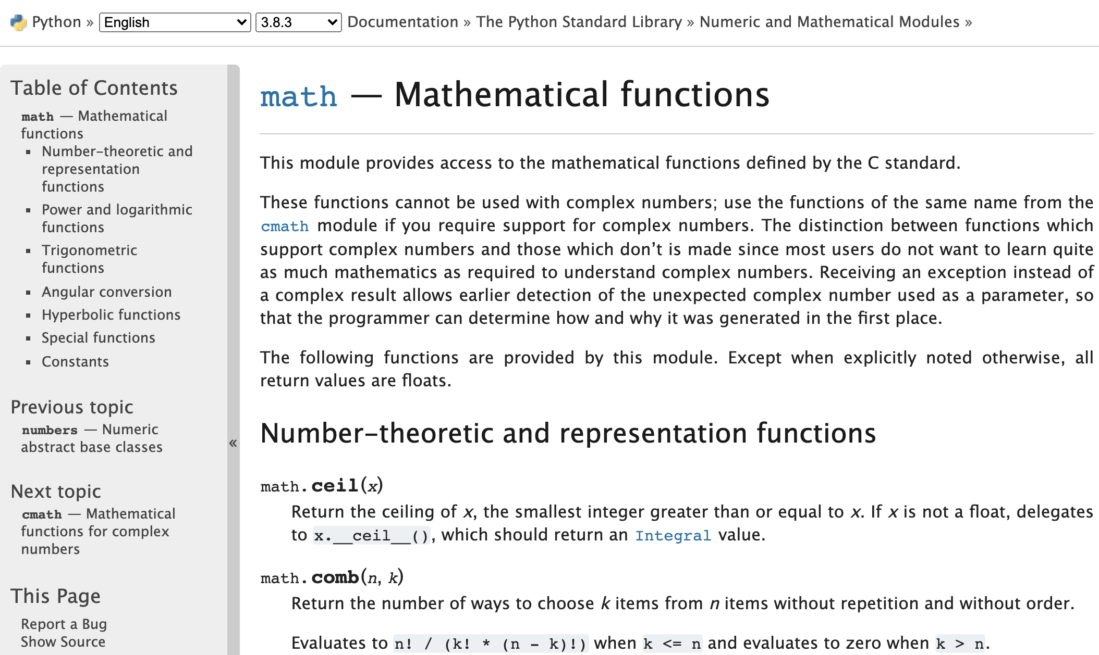
Mathematical functions
29
>>> import math
>>> print(math.exp(1))
>>> print(math.log(100,10))
>>> print(math.log(4,2))
>>> print(math.sqrt(4))
>>> print(math.pi)
>>> print(math.e)
https://docs.python.org/3/library/math.html

Slide 32
Practice
30
>>> 1 + 1 # => 2
>>> 8 - 1 # => 7
>>> 10 * 2 # => 20
>>> 35 / 5 # => 7.0
>>> 5 // 3 # => 1
>>> 5.0 // 3.0 # => 1.0 # works on floats too
>>> -5 // 3 # => -2
>>> -5.0 // 3.0 # => -2.0
>>> 10.0 / 3 # => 3.3333333333333335
>>> 7 % 3 # => 1
>>> 2**3 # => 8

Slide 33
Built-in Types
31
Variable
Sequence
index
CHE1 = '化熱'
CHE2 = '化動'
CHE3 = '單操'
CHE [0] = '化熱'
CHE = [ '化熱', '化動', '單操' ]
CHE [1] = '化動'
CHE [2] = '單操'
key
value
Mapping
CHE ['大二'] = '化熱'
CHE = {'大二':'化熱', '大三':'化動', '大四':'單操',…}
CHE ['大三'] = '化動'
CHE ['大四'] = '單操'

Slide 34
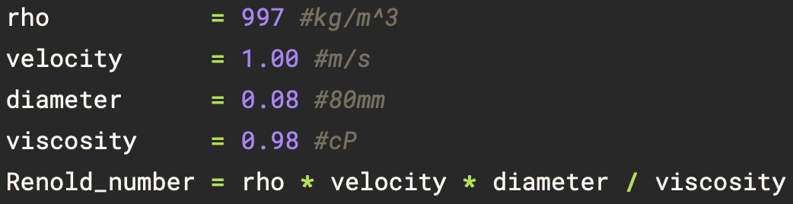
Variable and Assignment
32
Variable
(i) A-Z, a-z, 0-9, and underscore (_)
(ii) The first character of a variable name cannot be a digit
Assignment
(i) The equal sign (=) is used to assign a value to a variable

Slide 35
Built-in Types
33
Types | Name | Definition | Example
Numeric types | integer, float, complex |  | 1450, 9.2, 8+9j
Text Sequence Type | string | ' ' or " " | "NTHUCHE" 'NTHUCHE'
Sequence types | list | [ ] | [1,2,3]
 | tuple | ( ) | (1,2,3)
 | range | range() | range(3)
Mapping Types | dictionary | {key, value} | {'a':140, 'b':114}

Slide 36
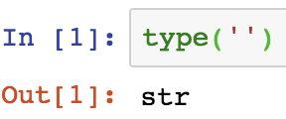
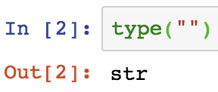
String
34
Index
Slice
a[start: stop(: step)]
>>> a[0:2] # characters from position 0 (included) to 2 (excluded) => 'NT'
>>> a[5:7] # characters from position 5 (included) to 7 (excluded) => 'HE'
>>> a = 'NTHUCHE'
>>> a[:2] # character from the beginning to position 2 (excluded) => 'NT'
>>> a[5:] # characters from position 5 (included) to the end => 'HE'
>>> a[-3:] # characters from the third-last (included) to the end => 'CHE'
'N'
'T'
'H'
'U'
'C'
'H'
'E'
>>> a[0:7:2] # => 'NHCE'
>>> a[::2] # => 'NHCE'
>>> a[0:6:-2] # => ' '
>>> a[6:0:-2] # => 'ECH'
>>> a[::-2] # => 'ECHN'
Index: 0 1 2 3 4 5. 6
Index: -7 -6 -5 -4 -3 -2 -1
len
Immutable
>>> a[0] # character in position 0 => 'N'
>>> a[6] # character in position 5 => 'E'
>>> a[-1] # last character => 'E'
>>> a[-2] # second-last character => 'H'
>>> a[-7] # => 'N'
>>> a[0] = 'C' # error
>>> a[2:] = 'NU' # error
>>> len(a) # => 7
>>> a[42] # error
>>> a[4:42] # => 'CHE'
>>> a[42:] # => ' '
Operators
>>> a[:] # => 'NTHUCHE'
>>> a[:2] + a[2:] # => 'NTHUCHE'
>>> a[:4] * 2 # => 'NTHUNTHU'

Slide 37
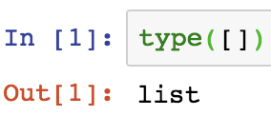
List [ ]
35
Index
Slice
a[start: stop(: step)]
>>> a[0:2] # => [1, 3]
>>> a[4:6] # => [9, 11]
>>> a[:2] # => [1, 3]
>>> a[4:] # => [9, 11]
>>> a[0:6:2] # => [1, 5, 9]
>>> a[::2] # => [1, 5, 9]
>>> a[6:0:-2] # => [11, 7, 3]
>>> a[0:6:-2] # => [ ]
>>> a[::-2] # => [11, 7, 3]
>>> a[:] # => [1, 3, 5, 7, 9, 11]
>>> a = [1, 3, 5, 7, 9, 11]
Note: All slice operations return a new list containing the requested elements.
1
3
5
7
9
11
Mutable
Index: 0 1 2 3 4 5
Index: -6 -5 -4 -3 -2 -1
>>> a[-1] = 13 # => [1, 3, 5, 7, 9, 13]
>>> a[0] # indexing returns the item 1
>>> a[-1] # => 11
len
Operators
>>> len(a) # => 6
>>> a = [1, 3]
>>> a += [5, 7] # => [1, 3, 5, 7]
>>> a *= 2 # => [1, 3, 5, 7, 1, 3, 5, 7]

Slide 38
Nested List
36
>>> nest = ['a', ['b', 'c'] , 'g']
'a'
['b', 'c']
'g'
# => nest[0] = 'a'
# => nest[1] = ['b', 'c']
# => nest[2] = 'g'
nest
Index 0 1 2
'b'
'c'
# => nest[1][0] = 'b'
# => nest[1][1] = 'c'
nest[1]
Index 0 1

Slide 39
Dynamic
37
list.append(obj)
list.insert(index, obj)
>>> x = [1, 2, 3]
>>> x.append('a')
>>> print(x) # => [1, 2, 3, 'a']
>>> x = [1, 2, 3]
>>> x.insert(2, 4)
>>> print(x) # => [1, 2, 4, 3]
Index 0 1 2 3
>>> x = [1, 2, 3]
>>> x.append([4, 5, 6])
>>> print(x) # => [ 1, 2, 3, [4, 5, 6] ]

Slide 40
Dynamic
38
list.pop( index = -1 )
del list[ index ]
>>> x = [1, 2, 3]
>>> y = x.pop()
>>> print(x) # => [1, 2]
>>> print(y) # => 3
>>> x = [1, 2, 3]
>>> del x[1]
>>> print(x) # => [1, 3]
>>> x = [1, 2, 3]
>>> del x[1:3]
>>> print(x) # => [1]
>>> x = [1, 2, 3]
>>> y = x.pop(1)
>>> print(x) # => [1, 3]
>>> print(y) # => 2
>>> x = [1, 2, 3]
>>> del x[:]
>>> print(x) # => []

Slide 41
Practice
39
>>> L = ['a', 'b', ['cc', 'dd', ['eee', 'fff']], 'g', 'h']
>>> print(L[2]) # => ['cc', 'dd', ['eee', 'fff']]
>>> print(L[2][2]) # => ['eee', 'fff']
>>> print(L[2][2][0]) # => eee
>>> L = ['a', ['bb', 'cc'], 'd']
>>> L[1].append('xx')
>>> print(L) # => ['a', ['bb', 'cc', 'xx'], 'd']
>>> L[1].insert(0, 'yy')
>>> print(L) # => ['a', ['yy', 'bb', 'cc', 'xx'], 'd']
>>> x = L[1].pop(1)
>>> print(L) # => ['a', ['yy', 'cc', 'xx'], 'd']

Slide 42
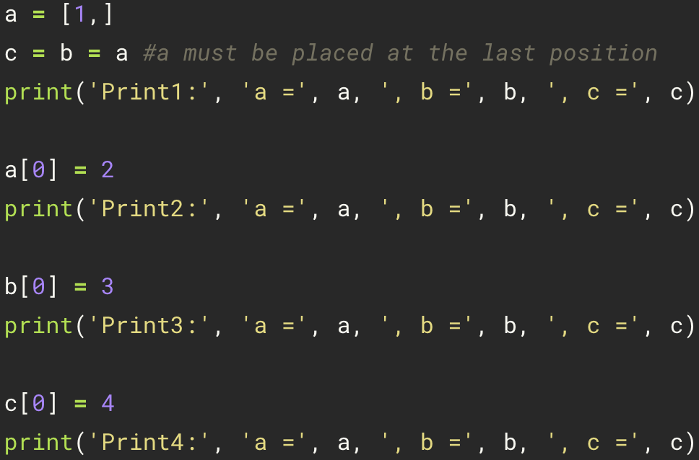
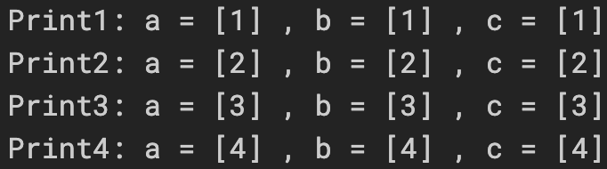
Mutability
40
Aliasing: if one variable is assigned to another, all variables refer to the same object

Slide 43
Mutability
41
a
a
a
[1, ]
[2, ]
[3, ]
b
b
b
c
c
c

Slide 44
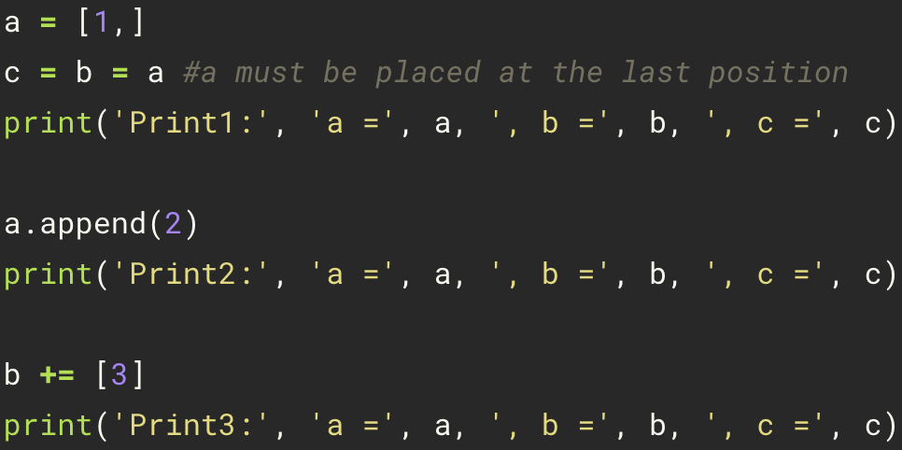

Dynamic
42
+=: Augmented assignment
For list, append() and “+=” are an in-place operation

Slide 45
Dynamic
43
a
a
a
[1, 2, 3, ]
[1, ]
[1, 2, ]
b
b
b
c
c
c

Slide 46


= vs. +=
44
If a variable is modified, it can't be mutated (creating a new object).

Slide 47


= vs. +=
45
a
a
[1, ]
[1, 2, ]
a
[1, 2, ]
b
b
b
c
c
[1, 2, 3, ]
copy
c

Slide 48


= vs. +=
46

Slide 49
List Copy
47
Aliasing
Cloning (copy)
b = list(a)
b = a[:]
b = a.copy()
b = a
[1, ]
a
a
[1, ]
b
[1, ]
b
copy

Slide 50

List Copy
48
only a is changed

Slide 51
List Copy
49
Shallow Copy
Deep Copy
b = list(a)
b = a[:]
b = a.copy()
import copy
a = [1, [2,3]]
b = copy.deepcopy(a)
nested list

Slide 52


Shallow Copy vs. Deep Copy
50
Shallow Copy
Deep Copy
>>> a = [ 1, [2, 3] ]
>>> b = a.copy()
>>> print('a =', a, ', b =',b)
>>> b[0] = 5
>>> b[1][1] = 6
>>> print('a =', a, ', b =',b)
>>> import copy
>>> a = [ 1, [2, 3] ]
>>> b = copy.deepcopy(a)
>>> b[0] = 5
>>> b[1][1] = 6
>>> print('a =', a, ', b =',b)
change

Slide 53
Practice
51
>>> x = [1, 2, 3]
>>> x[0] = -4
>>> print(x) # => [-4, 2, 3]
>>> y = x
>>> x[0] = x[0] + 4
>>> print(y) # => [0, 2, 3]
>>> x += [4]
>>> print(y) # => [0, 2, 3, 4]
>>> x = x + [4]
>>> print(x) # => [0, 2, 3, 4, 4]
>>> print(y) # => [0, 2, 3, 4]
>>> import copy
>>> a = [[1, 1], [2, 2]]
>>> b = a.copy()
>>> c = copy.deepcopy(a)
>>> a[0][1] = 3
>>> print(a) # => [[1, 3], [2, 2]]
>>> print(b) # => [[1, 3], [2, 2]]
>>> print(c) # => [[1, 1], [2, 2]]

Slide 54







Tuple ( )
52
Index
Slice
Operators
the same as list
Packing and Unpacking
>>> a = (1, 3, 5, 7, 9, 11) or >>> a = 1, 3, 5, 7, 9, 11
1
3
5
7
9
11
>>> a = (1, 2, 3)
Tuple packing
Index: 0 1 2 3 4 5
Index: -6 -5 -4 -3 -2 -1
>>> a[0] # indexing returns the item 1
>>> a[-1] # => 11
Immutable
match
Tuple Unpacking
>>> a[-1] = 13 # error
execute swap conveniently!!

Slide 55




Mutability vs Immutability
53
List
Tuple
Re2 sees the change
“+=“ is an in-place operation
Dynamic Re1
Re1 returns a new object
“+=“ is also an non-in-place operation
Copy new Re1

Slide 56




Reassigning Tuples
54
Tuple is immutable object

Slide 57

Range ( )
55
Index
Immutable
range(stop)
range(start, stop[, step])
>>> a[-1] = 13 # error
>>> a = range(6)
>>> a = range(0, 12, 2)
0
1
2
3
4
5
0
2
4
6
8
10
Index: 0 1 2 3 4 5
Index: -6 -5 -4 -3 -2 -1
0 1 2 3 4 5
-6 -5 -4 -3 -2 -1
range() does not produce a list of integers, but instead generates integers one by one as needed. This saves computer memory and can speed up programs.
>>> a[2] # => 2
>>> a[-1] # => 5
>>> a[2] # => 4
>>> a[-1] # => 10
Slice
Operators
the same as list

Slide 58
Built-in Types
56
Type | Mutable | Immutable | Example
integer, float, complex |  | ✓ | 1450, 9.2, 8+9j
string |  | ✓ | "NTHUCHE" 'NTHUCHE'
list | ✓ |  | [1,2,3]
tuple |  | ✓ | (1,2,3)
range |  | ✓ | range(3)
dictionary | ✓ |  | {'a':140, 'b':114}

Slide 59

Dict { }
57
Key
A dictionary key must be of a type
that is immutable!!!
Addition
>>> a = {}
>>> a['a'] = 1 # => {'a': 1}
>>> a['b'] = 2 # => {'a': 1, 'b': 2}
>>> d = {'int': 1, 'float': 2.2, 'bool': True}
>>> d['float'] # => 2.2
>>> a = {'a': 1, 'b': 3, 'c': 5, 'd': 7}
>>> a['a'] # => 1
>>> a['c'] # => 5
>>> d = {(1, 1): 'a', (1, 2): 'b', (2, 1): 'c'}
>>> d[(1,1)] # => 'a'
>>> d[(2,1)] # => 'c'
key:
'a'
'b'
'c'
'd'
>>> a = {0: 'a', 1: 'b’, 2.2: 'c'}
>>> a[0] # => 'a'
>>> a[2.2] # => 'c'
value:
1
3
5
7
len
Deletion
Mutable
>>> a = {'a': 1, 'b': 3, 'c': 5, 'd': 7}
>>> len(a) # => 4
>>> a = {}
>>> a['a'] = 1 # => {'a': 1}
>>> a['b'] = 2 # => {'a': 1, 'b': 2}
>>> del a['a'] # => {'b': 2}
>>> a['d'] = 9 # => {'a': 1, 'b': 3, 'c': 5, 'd': 9}

Slide 60
Keys and Values
58
>>> dict = {'a':1,'b':2}
Keys
Values
>>> keys = dict.keys()
>>> print(keys) # => dict_keys(['a', 'b'])
>>> values = dict.values()
>>> print(values) # => [1, 2]
<class 'dict_keys'>
<class 'list'>
returns a list of all the keys in the dictionary
Key and Values
>>> keys_values = dict.items()
>>> print(keys_values) # => dict_items([('a', 1), ('b', 2)])
<class 'dict_items'>
return a list of a given dictionary’s (key, value) tuple pair

Slide 61
Nest Dict { }
59
>>> family = {'grandpa': 'Jay', 'parent':['Peter', 'Lynn'], 'children':{'bro': 'Ping', 'sis': 'Xi'}}
key:
'grandpa'
'parent'
'children'
value:
'Jay'
['Peter', 'Lynn']
{'bro': 'Ping', 'sis': 'Xi'}
family['parent']
'Peter'
'Lynn'
'Ping'
'Xi'
family['children']
index: 0
1
key: 'bro'
'sis'
>>> family['grandpa'] #=> 'Jay'
>>> family['children'] #=> {'bro': 'Ping', 'sis': 'Xi'}
>>> family['parent'] #=> ['Peter', 'Lynn']
>>> family['children']['bro'] #=> 'Ping'
>>> family['parent’][0] #=> 'Peter'

Slide 62
Dynamic
60
update
clear
>>> a = {'a':1}
>>> b = {'b':2, 'c':3}
>>> a.update(b)
>>> print(a) # => {'a': 1, 'b': 2, 'c': 3}
>>> a = {'zero':0, 'one':1}
>>> a.clear()
>>> print(a) # => {}

Slide 63
Practice
61
>>> x, y = 1, 2 >>> print(x) print(x) # => 1 >>> print(y) print(y) # => 2 >>> t = (10, 20) >>> x, y = t >>> print(x) # => 10 >>> print(y) # => 20 >>> x, y = y, x >>> print(x) # => 20 >>> print(y) # => 10
>>> a = {}
>>> a = {'zero':0}
>>> a['one'] = 1
>>> print(a) # => {'zero': 0, 'one': 1}
>>> a['zero'] = 2
>>> print(a) # => {'zero': 2, 'one': 1}
>>> a = {'x':{'x0':0,'x1':1}, 'y':{'y0':0,'y1':1}}
>>> a['x']['x0'] = 2
>>> a['y']['y1'] = 3
>>> print(a)

Slide 64
Object
62
PyObject
Type | integer
Value | 1
Reference Count | 1
>>> x = 1
Python Name
x
PyObject
Type | integer
Value | 1
Reference Count | 0
>>> x = 2
Python Name
x
PyObject
Type | integer
Value | 2
Reference Count | 1

